Slide 1
DevOps
By- Lakshmi Kalatippi
Vivek Kumar
Sumit Kumar

Slide 2
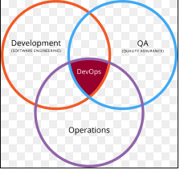
INTRODUCTION TO DEVOPS
Evolution of Software Development process
What is DevOps ?
Phases of DevOps

Slide 3
DevOps Tools:-
Source Code management and Version Control
Build
Continuous Testing
Continuous Integration
Configuration Management
Continuous Monitoring

Slide 4
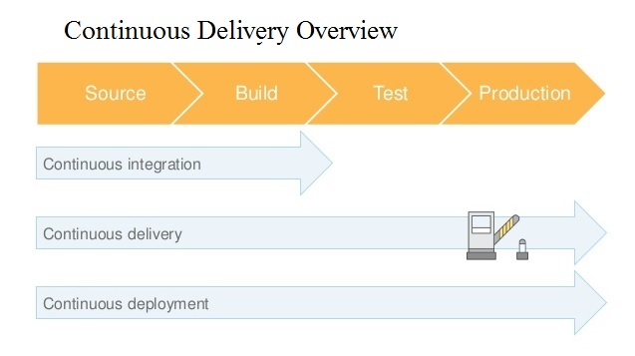
AWS Code Services
Aws Code CodeCommit
Code Pipeline
Code Deploy

Slide 5
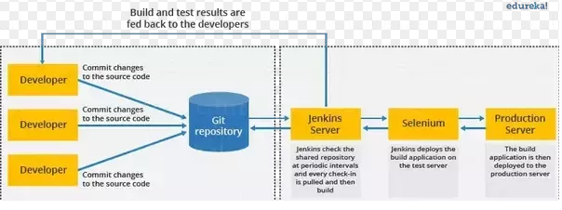
Developing Application Using Jenkins
What is Jenkins ? Why we Used ?
Advantages of Jenkins
Configuration & Installation of Jenkins & Tomcat
Flow Diagram of Jenkins

Slide 6
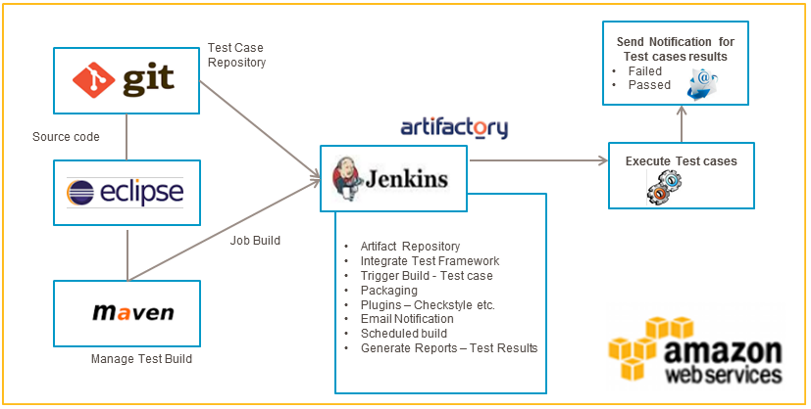
Test Automation
Setup the AWS environment for test operations
Setup of Eclipse setup with required plugins on the AWS instances
Configured Open source tools Maven, Jenkins, Jenkin Plugins on EC2 instance windows instances
Jenkins build to pickup selenium jars to start running tests

Slide 7
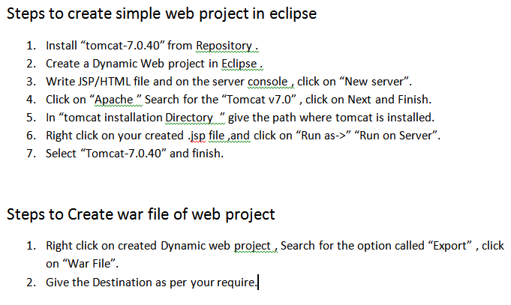
Steps to create simple web project in eclipse

